Slide 1
Employee Data Analysis using Excel
STUDENT NAME:S.Abinayasri
REGISTER NO:3122167532
DEPARTMENT:B.Com AF
COLLEGE:Shri Krishnaswamy College For Women

Slide 2
PROJECT TITLE
Employee Performance Analysis using Excel

Slide 3


AGENDA
Problem Statement
Project Overview
End Users
Our Solution and Proposition
Dataset Description
Modelling Approach
Results and Discussion
Conclusion
3/21/2024 Annual Review

Slide 4

PROBLEM STATEMENT
Performance scores and Ratings:
There is a notable disparity in performance scores and current ratings
Among employee, even within the same job function and department.
This variabitly may reflect underlying issues in performance management
Or assessment criteria.
Employee Turnover:
The data indicates several recent terminations, which could be a sign of
Underlying issues such job dissatisfaction, management problems, or external
Factors affecting employee retention.

Slide 5

PROJECT OVERVIEW
Employment Guidelines Document:
Comprehensive guidelines outlining contract types,employee statues and management
Practrices to ensure uniformity across the organization.
Demographic Analysis Report:
A report analyzing the impact of demographic factors on performance and job
Satisfaction, with actionable insights for improving eqity and support.

Slide 6

WHO ARE THE END USERS?
Department Heads and Management:
Sales Managers: Use performance data to manager and support their team, assess
Individual performance and address any issues or needs.
Production Managers: Utilize employee data to optimize production workflows, manager
Staffing levels, and ensure that performance standards are met.
Employee Relations Specialists:
Employee Relations Managers: Focus on resolving employee issues, improving job
Satisfaction and Managing employee terminations or transitions.

Slide 7

OUR SOLUTION AND ITS VALUE PROPOSITION
Data-Driven Insights for Continuous Improvement:
Leveraging data to inform decisions helps the company stay aggle and
Responsive to emerging trends and challenges enabling continuous
Improvement in employee management and performance.
Better Resource Allocation:
Understanding the impact of semographic factors and performance
Trends allows for more effective allocation of resources,training and support
Maximizing the return on investment in human capital.

Slide 8
Dataset Description
1.EmpID:Unique identifier for each employee.
Type:Numeric
Description: A unique code assigned to each employee for identification purposes.
2.First Name:Employee’s first name.
Type:String
Description:The given name of the employee.
3.Last Name:Employee’s last name.
Type:String

Slide 9

THE "WOW" IN OUR SOLUTION
Performance and Demographics Integration:
By combining performance scores with demographics data,the dataset
Enables the identification of patterns and trends for instance it helps
In analyzing performance across different departments, races,genders,
And material statuses,providing valuable insights for diversity and
Inclusion initiatives.
3/21/2024 Annual Review
9

Slide 10
MODELLING
Data Preparation:
Missing values: Identify and handle missing values in critical fields like EXIT data, performance score.
Consistency Checks: Ensure data consistency in fields such as Employee type and payzone.
Data Formatting :Convert dates to a consistent format for easier analysis.
10

Slide 11
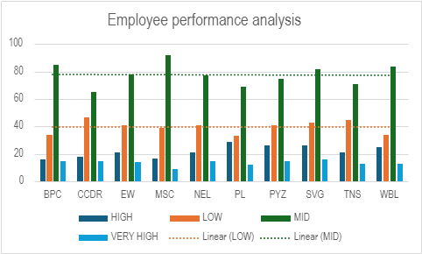
RESULTS
11

Slide 12
conclusion
Performance Insights:
Performance Ratings:
Most employees fall into the “Fully Meets” category, indicating that overall performance
Aligns with expectations.
A notable number of employee rated “Exceeds” tend to have higher performance scores.
Areas for Improvement:
Employee in the “Area sales Manager” role show a wider range of ratings suggesting
a possible need for targeted performance management or training programs.
Demographic Analysis:
Race and Ethnicity: A diverse racial representation is observed,with a predominance.

